Slide 1
Rust System Programming Vulnerabilities Detection Using Dynamic Debugging
Visesh Bentula Teja Reddy Mandadi Umapathi Konduri

Slide 2
Introduction
Why Choose Rust for System Programming?
Memory Safety: Rust's ownership model and type system prevent common bugs such as buffer overflows and null pointer dereferencing, without the overhead of garbage collection.
Growing Adoption: Increasing use in system-level applications, from operating systems to game development, due to its performance and reliability.
Importance of Debugging and Vulnerability Detection
Prevention of Errors: Early detection of logical and runtime errors can prevent bugs from becoming security vulnerabilities.
Enhanced Stability and Security: Proper debugging helps maintain system stability and security, crucial for software reliability.

Slide 3
Motivating Example
Buffer Overflow in Servo: A real issue was found in Mozilla’s Servo browser engine using LLVM’s AddressSanitizer, where unsafe pointer usage led to a buffer overflow. This shows that even in Rust, unsafe blocks need careful handling.
Use-After-Free Caught by Miri: In a Rust application, Miri detected a use-after-free error — when memory was accessed after being deallocated. This highlights bugs that can occur in concurrent or unsafe code, despite Rust’s strong guarantees.
Tool Combination for Better Detection: Tools like GDB, LLVM sanitizers, and Miri were used together to catch vulnerabilities more effectively, showing that dynamic debugging complements Rust’s compile-time checks.
Real-World Impact: These tools help developers write safer, more reliable software — especially critical in fields like finance, healthcare, or embedded systems, where security and stability are essential.

Slide 4
Research Questions
Q1. How effective are dynamic debugging tools in identifying vulnerabilities in Rust system programming?
Ans) Dynamic debugging tools like Miri, GDB, and LLVM sanitizers are highly effective in detecting runtime bugs, such as use-after-free, out-of-bounds access, and undefined behavior—especially in unsafe Rust code that static checks might miss.
Q2. Which vulnerabilities are commonly missed by static analysis but caught by dynamic debugging?
Ans) Use-after-free errors, Unaligned or invalid pointer, accessBuffer overflows in unsafe blocks, Data races in multithreaded contexts: These are usually caught by tools like AddressSanitizer or Miri during execution, rather than compile time.

Slide 5
Related work
Rust's Security Features: Studies on Rust's memory safety, ownership, and borrowing rules.
Comparative Security Analysis: Research comparing Rust with other system programming languages like C++ and JAVA.
Dynamic Debugging Tools:
GDB: Debug Rust programs at runtime.
LLVM Sanitizers: Detect memory safety errors at runtime by instrumenting the compiled code.
Miri: Detect undefined behavior by interpreting Rust’s Mid-level Intermediate Representation
Vulnerability Detection Techniques: Evaluations and proposals for detecting system-level vulnerabilities.

Slide 6
Proposed Approach
Methodology:
Dynamic Analysis: Analyze running Rust programs to detect vulnerabilities.
Integration with cargo test: Merge testing and dynamic debugging to analyze vulnerabilities in real-time during tests.
Experimental Setup:
Create test scenarios simulating common Rust vulnerabilities (e.g., buffer overflows).
Apply dynamic debugging tools to these tests, capturing and analyzing output.
Data Analysis:
Assess the effectiveness of each tool in identifying and diagnosing
different types of vulnerabilities.
Expected Outcomes:
Enhanced identification of vulnerabilities in Rust.
Development of best practice guidelines for using dynamic debugging tools in Rust programming.

Slide 7
Experimental Method
Example 1: Rust Program with Memory Bug
Consider a Rust program (examples/buffer_overflow.rs) that has an intentional buffer overflow using an unsafe block:
// buffer_overflow.rs
fn main() {
let arr = [1, 2, 3, 4];
unsafe {
// Deliberately read out of bounds (index 4 is out of range 0-3)
let val = *arr.as_ptr().add(4);
println!("Read value: {}", val);
}
}

Slide 8
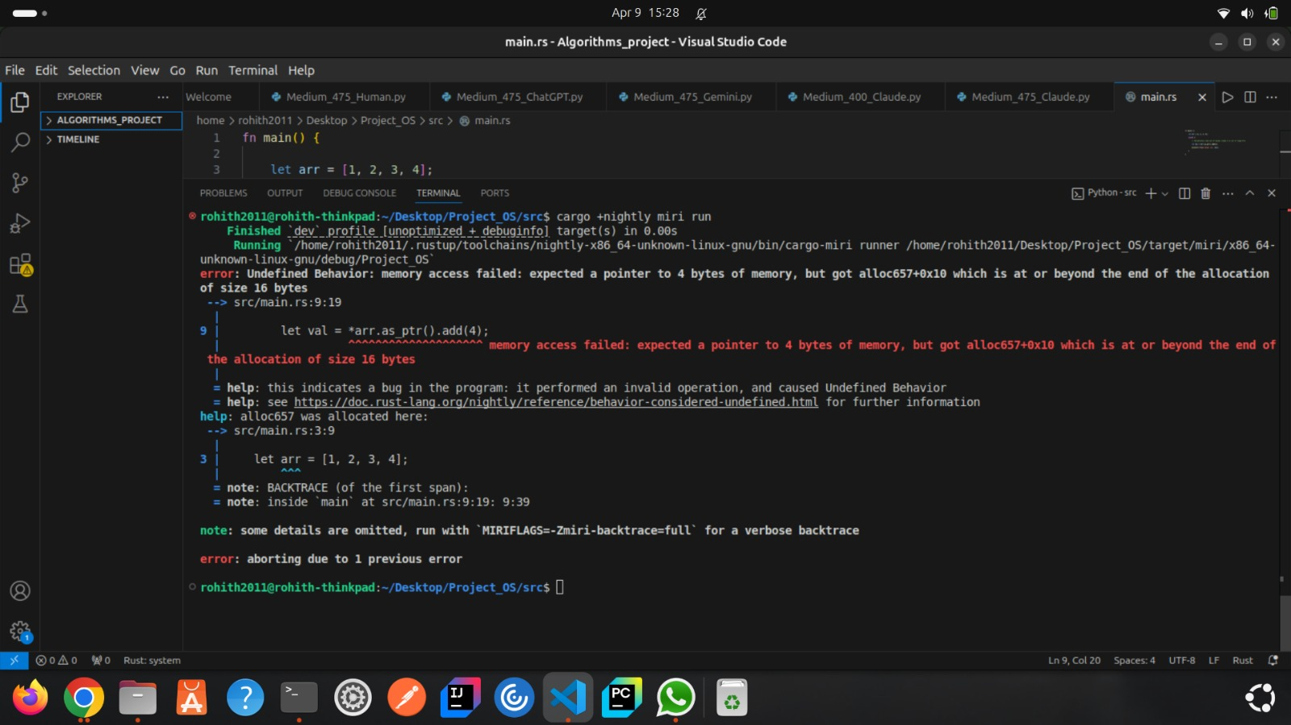
Experimental Output
“Here, Miri successfully identified an unsafe memory access in Rust. Even though Rust enforces memory safety, this example proves that tools like Miri are essential to catch edge-case errors at runtime, especially when using unsafe code.”

Slide 9
Conclusion
Summary:
Rust's inherent safety does not completely eliminate runtime vulnerabilities
Dynamic debugging using multiple tools enhances code security and stability
🔮 Future Considerations
✅ Add automatic testing and deployment with debugging tools
🛠️ Use advanced sanitizers to catch hidden bugs and memory issues
🔧 Keep improving Rust’s debugging tools for easier and better development

Slide 10
THANK YOU

